Slide 1
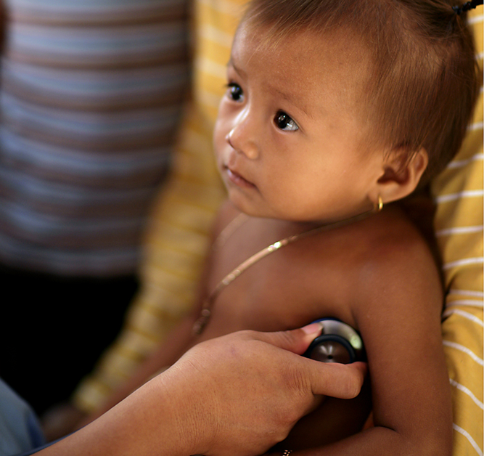
Clinical Characterisation Protocol
How do I operationalise CCP Global?
Notes for the Principal Investigator

Slide 2



Key Points
Resources can be found on our website
https://isaricresearch.github.io/CCP-Study-Documents/CCP_toolkit
For the collection of data and biological samples in a globally harmonised manner
This is an observational study, using data collected routinely as a part of clinical care
Adaptable protocol, depending on site resources
For successful study implementation, it is important for the study not to be seen as a separate activity in the facility’s response strategy to COVID-19
A Principal Investigator (PI) must be appointed
They will be responsible for all aspects of the study, following the main steps outlined in these slides

Slide 3






6 Steps to Operationalise the CCP
Determine Site Capacity
Prepare Documentation/
Obtain Ethics/IRB Approval
Planning Resources
The Patients Journey
Community & Public
Engagement
Screening & Study
Enrolment

Slide 4
Overview of the Protocol
Inclusion Criteria
Children and adults with suspected or confirmed infection
Data Collection (Module 0 to Module 3)
ISARIC ARCHetype Case Report Form (paper CRF or web-based electronic “eCRF”) ready to use or to be adapted
Depending on local resources, interest and feasibility, chose which tier to use
Sites are encouraged to enter data using the eCRF(s)
Module 0
Patient data (CRF)
Sampling (Module 1 to Module 3)
Read the Clinical Characterisation Protocol to make an assessment to decide if you have the resources and capacity to do: Sampling on enrolment (Module 1) and / or Serial Sampling (Module 2 or 3)
Tier 1
Patient data (CRF)
Sample obtain for clinical purpose
Tier 2
Patient data (CRF)
Simple & stable samples
Tier 3
Patient data (CRF)
Samples obtained for the primary purpose of research

Slide 5



Step 2 – Prepare Documentation/Obtain Ethics/IRB Approval; Key Points
Check appropriate local/national guidelines;
As a guide, patients should only be enrolled once
appropriate approvals have been obtained for the applicable site
Example responses for ethics applications can be found in the CCP Resources Library: https://isaricresearch.github.io/CCP-Study-Documents/ccp_resources
Develop standard operational procedures (SOPs) to be used by the study team
Documents are available: https://isaricresearch.github.io/CCP-Study-Documents/ccp_resources
Organise a Study Master File (electronic/paper)
Example of SMF Structure : https://isaricresearch.github.io/CCP-Study-Documents/ccp_resources

Slide 6

Step 3 – Planning Resources; Key Points (1/3)
Principal Investigator takes overall responsibility for the study at their site
Requires a team who can undertake many roles (note: One person can carryout many roles) e.g.
People to take consent - can be done by clinical team caring for the patient
People to take samples from patient
People to transport the samples to the laboratory for analysis
People to process and analyse the samples
People to complete the CRF
May not require patient contact
May include a person who has access to medical records (if completing data retrospectively)

Slide 7

Step 3 – Planning Resources; Key Points, (2/3) continued…
Case Study, Malawi
First priority was staff safety and the difficulty in taking samples and collecting data per patient.
Established a team of three per patient – overview given in table below:
Team Member | PPE Context | Role
1 | 1 – full (single use) | Measures physiological observations and collects samples.
2 | 2 – less restrictive (sessional use) | Collects data from notes and witnesses Informed Consent.
3 | 2 – less restrictive (sessional use) | Supports Team Member 1 (double bagging and packing of samples; Runner – in case of unforeseen circumstances; Delivers samples to specimen collection reception before transfer to lab.
PPE guidance taken from the UK Governments’ Public Health England Guide ‘Recommended PPE for healthcare workers by secondary care inpatient clinical setting, NHS and independent sector’. Link below:
https://assets.publishing.service.gov.uk/government/uploads/system/uploads/attachment_data/file/879107/T1_poster_Recommended_PPE_for_healthcare_workers_by_secondary_care_clinical_context.pdf

Slide 8

Step 3 – Planning Resources; Key Points, (3/3) continued…
Consider establishing a core team e.g. nurse(s), physician(s), focal lab technician/assistant/pharmacist etc.
They can assist with the day-to-day study activities e.g. ensure all study resources are available for recruitment i.e. CRFs - digital PDA/tablet, or paper-based, sample collection kits etc.
Ensure all relevant hospital staff are familiar with the study procedures from the Triage Room, to A&E, to ICU etc.
Share contact information with other hospital staff
Provide regular study updates to all facility staff
More key points on planning and resources can be found in our toolkit; ‘Site Capacity: Points to Consider’ guidance document : https://isaricresearch.github.io/CCP-Study-Documents/CCP_toolkit

Slide 9
Step 4 – The Patients Journey; Key Points
Ensure study is well integrated into the routine health/facility system e.g. use a 'dedicated isolation room', for treating, consenting, sample(s) collection etc.
Ensure appropriate PPE is available at facility:
Staff safety must come first
Consider partnering with facility’s nearby to share commodities/purchase equipment in bulk
Ensure all staff are trained for PPE use:

Slide 10
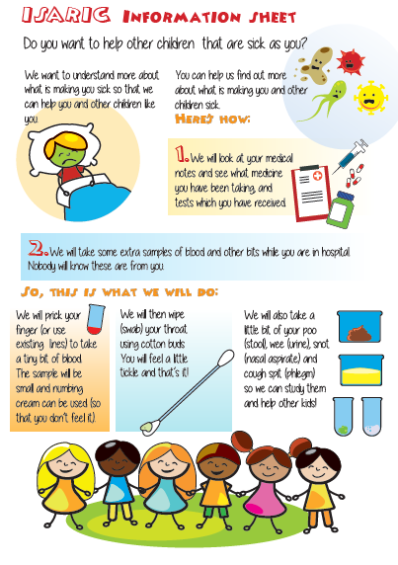
Step 5 – Community & Public Engagement; Key Points
Example leaflet:
Community engagement – patient and family education
ISARIC have ‘Participant Information Sheets’ and ‘Guidance notes for the Consultee’
Use these to personalise to local context (check with IRB/Ethics Committee)
Consider creating other materials e.g. Poster explaining the study for display on ward(s)/A&E etc.; other facilities may be interested in collaborating e.g. public health/epidemiologists etc.
Where possible, translate materials into the local language
Use simple terms that can be well understood by patients, families, wider communities, lay hospital staff etc.

Slide 11
Step 6 – Screening & Study Enrolment; Key Points (1/2)
Principal Investigator can decide who will do which procedures based on experience and training
For more information, review our ‘Competency/Training Needs: Points to Consider’ guidance document: https://isaricresearch.github.io/CCP-Study-Documents/CCP_toolkit
All staff must understand the reason for the study and be familiar with local procedures
Other training depends on role, e.g.
Consent training for those obtaining consent from participants
Data entry training for those using the eCRF
Hygiene and safety measures e.g. Putting on (donning) / taking off (doffing) PPE

Slide 12
Step 6 – Screening & Study Enrolment; Key Points, (2/2) continued…
Laboratories and samples (skip if working to tier 0 only)
Laboratory biosafety procedures and the appropriate BSL2, BSL3 or BSL4 safety management and guidelines are in place (dependent on local/national guidelines)
Refer to WHO for general guidance
Procedures for serial sampling, including the appropriate timings of serial samples, as per the protocol (Module 2 and 3)
Procedures for biological sample processing involving manual techniques and/or use of laboratory equipment (as specified in the protocol)
Documentation for sample processing, including sample handling and labelling

Slide 13
Thank you
Please visit the study website https://isaricresearch.github.io/CCP-Study-Documents/CCP_toolkit where resources i.e. checklists / templates, training materials and case studies (describing how other site’s have operationalised the CCP in their setting) are available for use
Please contact data@isaric.org to let us know if you are undertaking CCP Global at your site; and/or wish to provide (for our website), any locally adapted resources

Slide 14
ISARIC Funders

